Slide 1

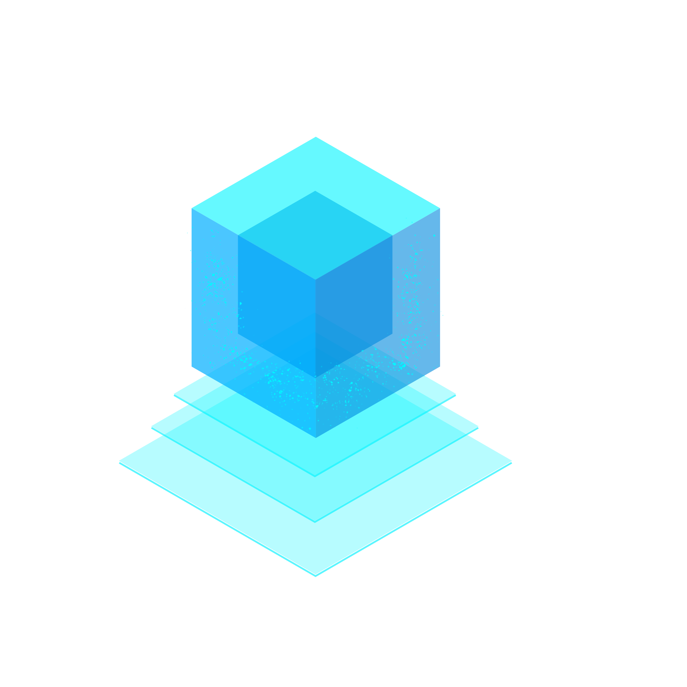
ELECTRONIC HEALTH RECORD USING BLOCKCHAIN UNITED COLLEGE OF ENGINEERING AND RESEARCH, PRAYAGRAJ DEPARTMENT OF COMPUTER SCIENCE AND ENGINEERING
PROJECT MENTOR- Mrs. PALLAVI SHUKLA

Slide 2
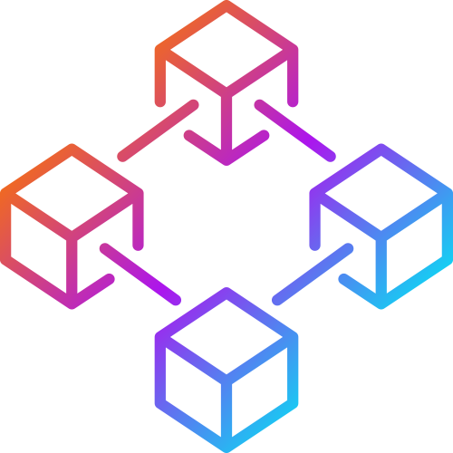
Using Block Chain for Electronic Health Records

Slide 3
INDRODUCTION
1
Let’s start

Slide 4
Blockchain technology is going to revolutionize healthcare and the method in which every patient interacts.

Slide 5
What is Electronic Health Records (EHR)
Electronic Health Record (EHR) is longitudinal electronic record of patient health information
EHR contains all personal health information belonging to an individual; entered and accessed electronically by health care providers.

Slide 6
What is Block Chain ?
Blockchain is a chain of blocks that are connected together and are continuously growing by storing transactions on the blocks.
BlockChain uses a decentralized approach that allows the information to be distributed and that each piece of distributed information or commonly known as data have shared ownership.

Slide 7
What is BlockChain Contd..
BlockChains holds batches of transactions that are hashed thus providing them security and they are managed by peer-to-peer networks.

Slide 8
Why BlockChain For EHR ?
Existing System Problems :
INTEROPERABILITY- The information should be exchangeable and must be usable for further purposes. In EHR systems its Health Information Exchange (HIE) or in general data sharing aspect. With a number of EHR systems being deployed in various hospitals they have a varying level of terminologies, technical and functional capabilities which makes it to have no universally defined standard

Slide 9
Why BlockChain For EHR ? Contd.
INFORMATION ASYMMETRY -The information is centralized to only a single healthcare organization and its control is only provided to the hospitals or organizations .I.e. If a patient wants to access his medical records he would have to follow a long and tedious process to access them.
DATA BREACHES -Data breaches in healthcare sector also calls for the need of a better platform.

Slide 10
Why BlockChain For EHR Contd.
Proposed System :
DECENTRALIZATION
With blockchain the information is distributed across the network rather than at one central point. It makes the control of information to be distributed and handled by consensus reached upon by shared input from the nodes connected on the network.
DATA TRANSPARENCY
The data or record at stake should be secured and temper proof. Any data being stored on the blockchain is not concentrated at one place and is not controlled by one node but is instead distributed across the network. The ownership of data is now shared and this makes it to be transparent and secure from any third party intervention.

Slide 11
Why BlockChain For EHR Contd.
SECURITY AND PRIVACY
Blockchain technology uses cryptographic functions to provide security to the nodes connected on its network. It uses SHA-256 cryptographic algorithm on the hashes that are stored on the blocks.

Slide 12
SMART CONTARCT
smart contracts are an important part of DApps as they are used for performing basic operations. Following contracts are included in this framework • Patient Records • Roles
These contracts are used for giving access to the users on the DApp and performing CRUD operations on the records of patient.

Slide 13
SMART CONTARCT Contd.
The Patient Records smart contract is made purely for implementing the functionality of the proposed framework.
Roles is a predefined smart contract by the Open Zeppelin smart contract library. This library contains several smart contracts performing various functionalities that could be used for creating our own functions.

Slide 14
SMART CONTARCT Contd.
This role based access would ensure that no third party is accessing these functions and only the authenticated users of the system would have access to these functions.

Slide 15
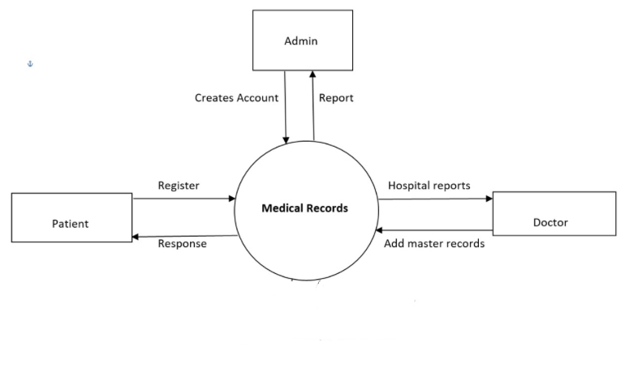
LEVEL 0-DATA FLOW DIAGRAM

Slide 16
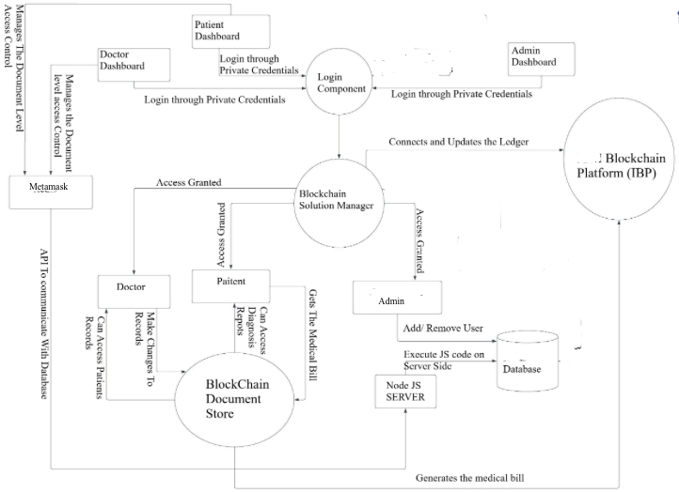
LEVEL 1- DATA FLOW DIAGRAM

Slide 17
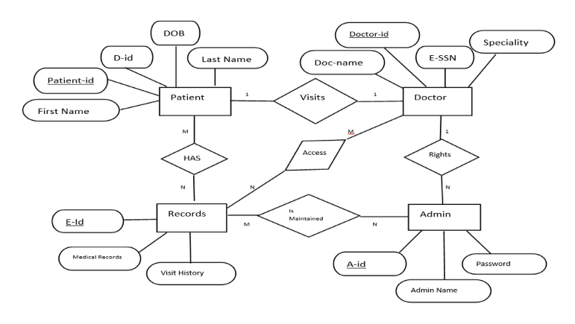
ER DIAGRAM

Slide 18
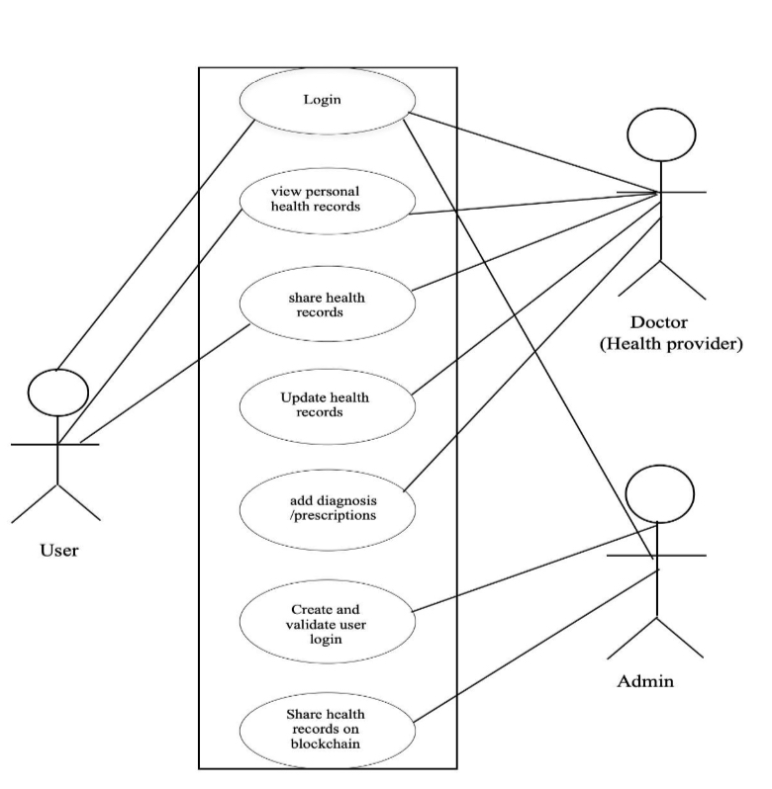
USE CASE DIAGRAM

Slide 19
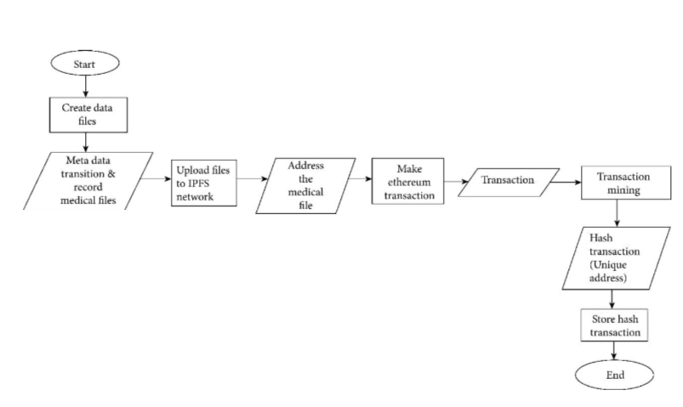
FLOW CHART OF PROPOSED MODEL

Slide 20
Comparison of proposed framework with related work.
 | Existing | Proposed
BlockChainBased | N | Y
Scalabilty | N | Y
Acees Control | Y | Y
Decentralized | N | Y
Interoperability | N | Y

Slide 21
WORKING EXAMPLE FOR PROPOSED FRAMEWORK
The system mainly has two entities, i.e., Administrator and User. Users are further divided into two categories for our proposed framework they are doctor and patient. These users are assigned roles by the administrator of the system who is someone belonging to the hospital’s administrative staff. Here administrator is assigned the task of the defining the granular access to two main users of our system, i.e., doctor and patient .

Slide 22
The Admin function can only be accessed by System Administrator if Any others try to Access the function it throws a Error.!! Message For E.g. :- Doctor try to access Admin Function Figure Given →

Slide 23
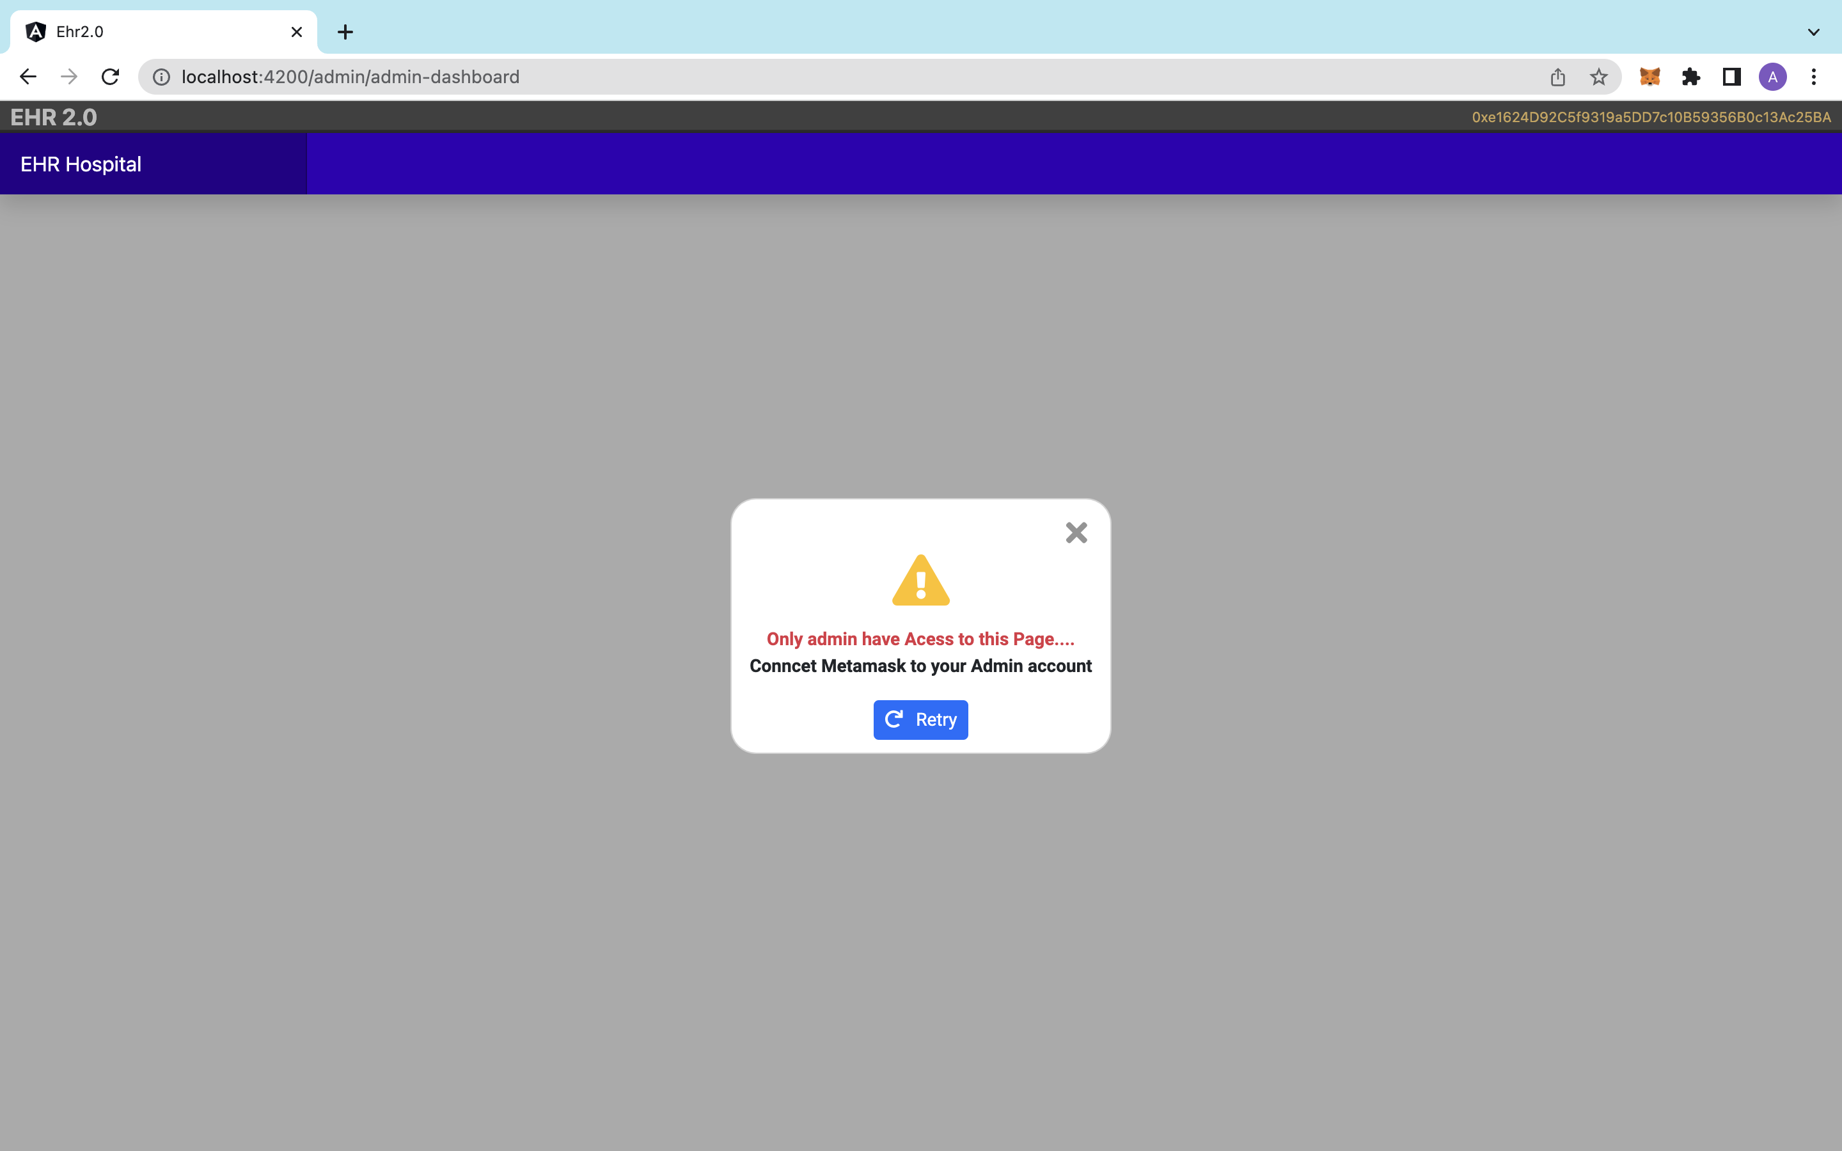

Slide 24
ADMIN MODULE Admin Can:
Add Doctor to the Network
Add Patient to the Network
Delete User(Doctor/Patient)

Slide 25
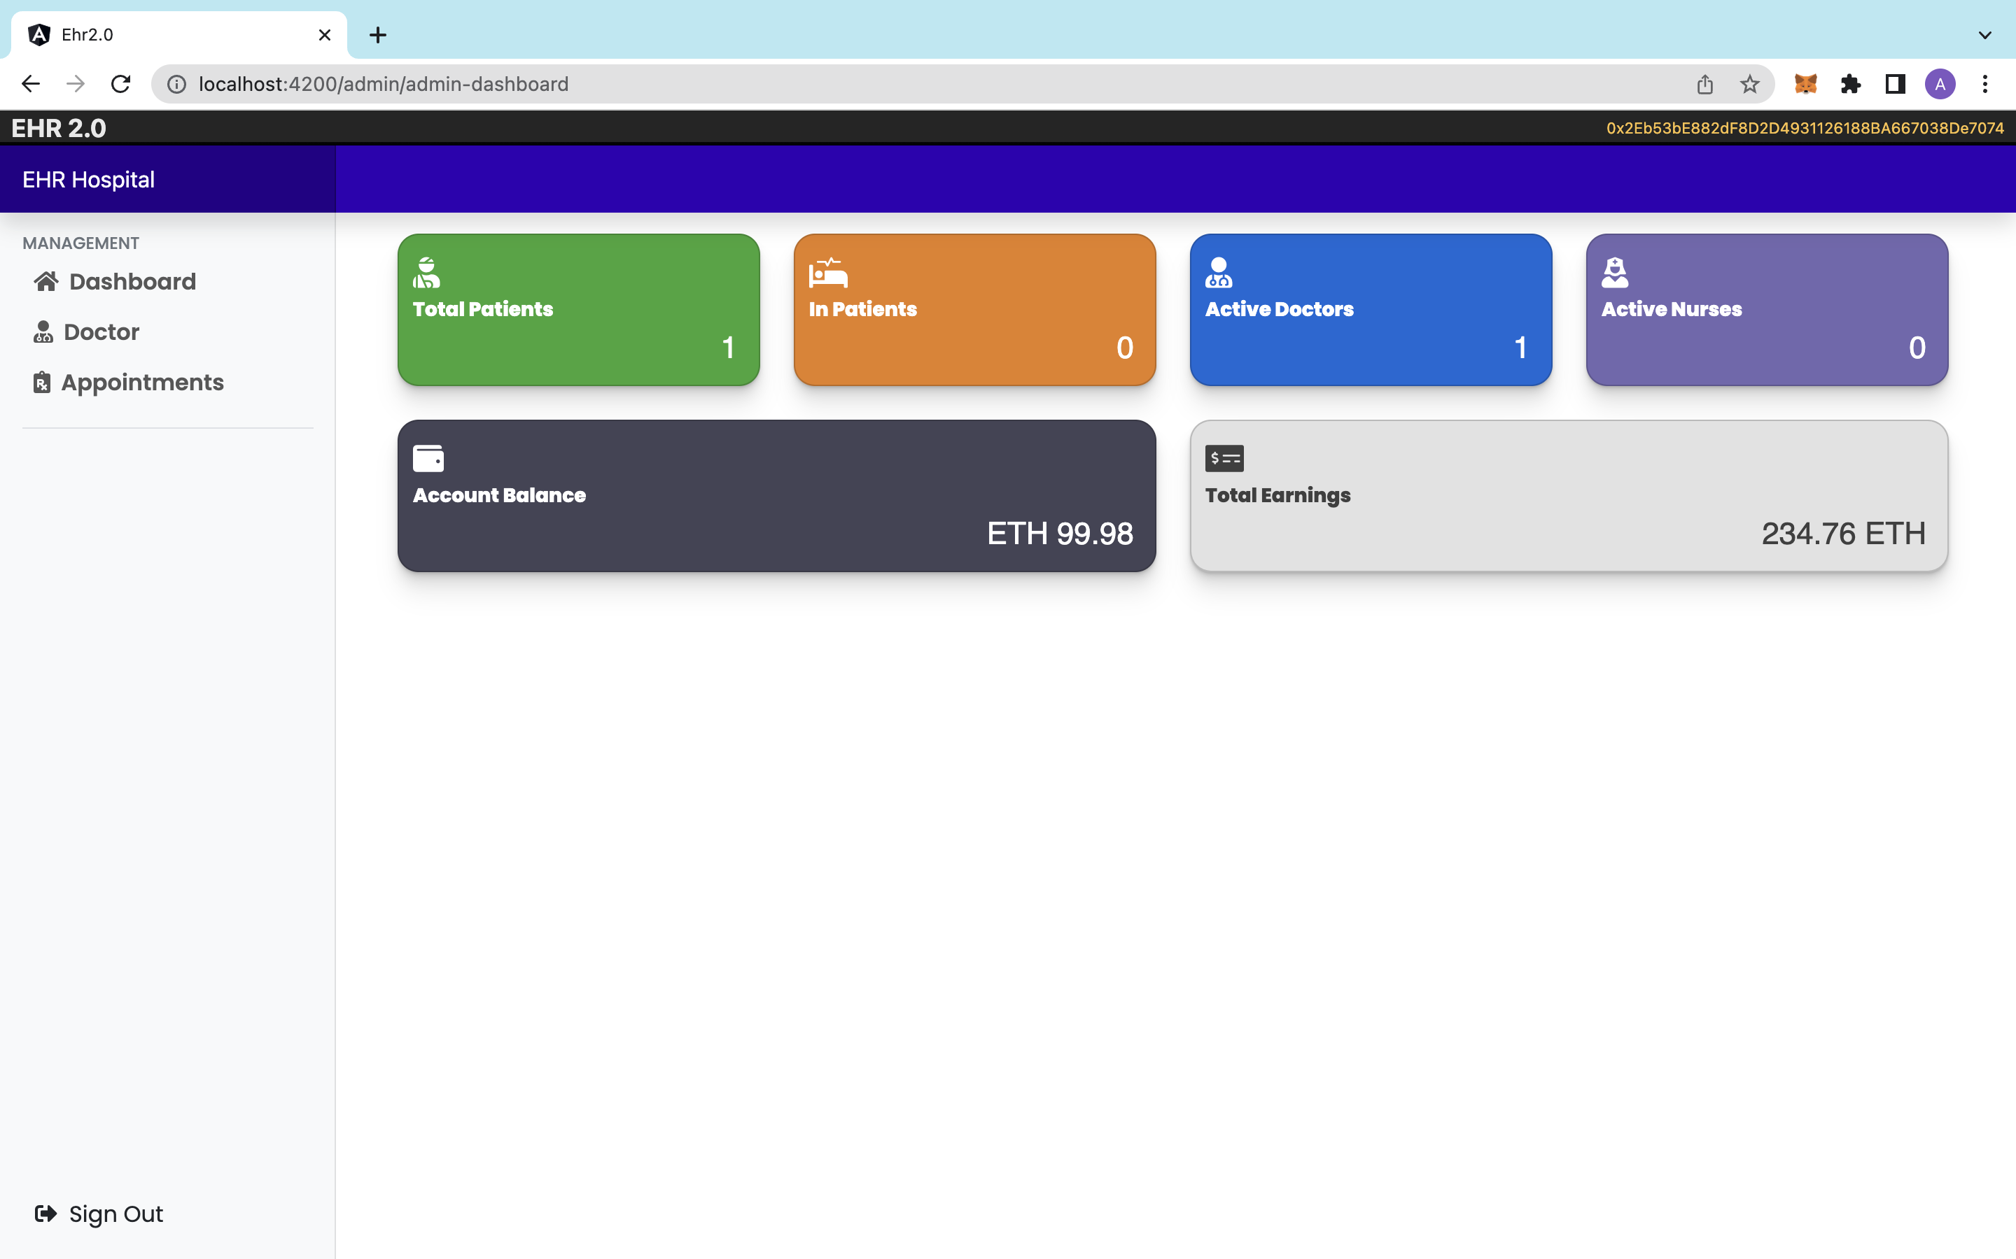

Slide 26
DOCTOR Module
DOCTOR Can :
Add Patient Record
View Patient Record
Update Patient Record
Delete Patient Record
Edit Doctors Info

Slide 27
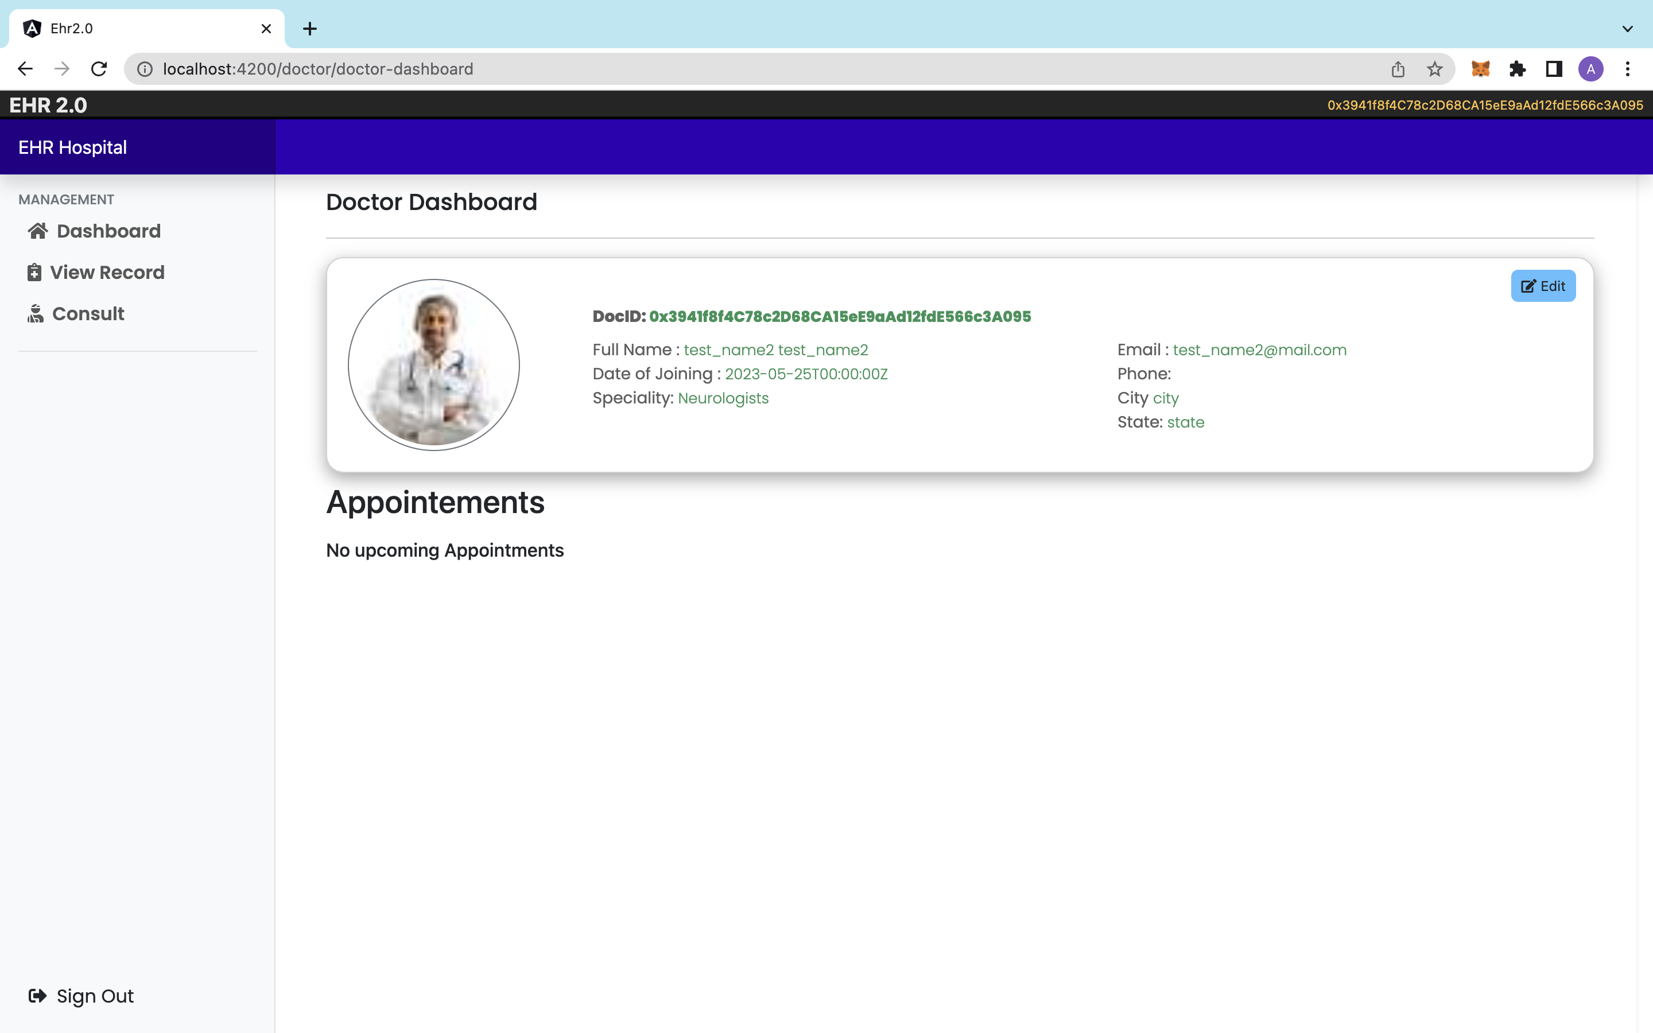

Slide 28
PATIENT MODULE
PATIENT CAN :
View medical info
Edit About info

Slide 29
Development Environment
Front End :
ReactJS, HTML, CSS,JS
Back End :
NodeJS, Ganache(BlockChain), Truffle Framework,
Metamask Browser extension (Connect Browser to Blockchain),
Some NodeJS Libraries.
IDE :
VSCode

Slide 30
THANK YOU!

